Slide 1
IMAGE COMPRESSION AND
WATERMARKING
ICT4201: DIP

Slide 2
PREVIEW
The art and science of reducing the amount of data required to represent an image
The process of inserting visible and invisible data (such as copyright information) into images

Slide 3
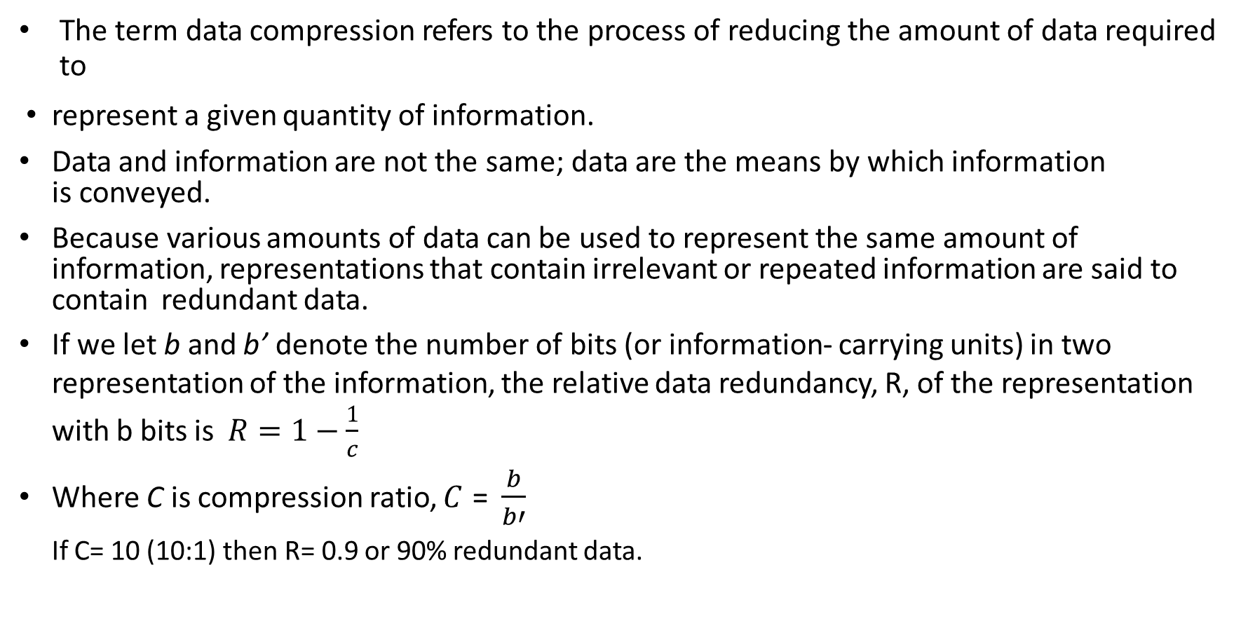
FUNDAMENTALS OF IMAGE COMPRESSION
The term data compression refers to the process of reducing the amount of data required to
represent a given quantity of information.
Data and information are not the same; data are the means by which information is conveyed.
Because various amounts of data can be used to represent the same amount of information, representations that contain irrelevant or repeated information are said to contain redundant data.
If we let b and b’ denote the number of bits (or information- carrying units) in two representation of the information, the relative data redundancy, R, of the representation with b bits is $R=1−\frac{1}{c}$
Where C is compression ratio, 𝐶 = $\frac{b}{b′}$
If C= 10 (10:1) then R= 0.9 or 90% redundant data.
1
𝐶
_{𝑏}𝘍

Slide 4
FUNDAMENTALS OF IMAGE COMPRESSION
Two-dimensional intensity arrays suffer from three principal types of data redundancies that can be identified and exploited:
Coding redundancy. A code is a system of symbols (letters, numbers, bits, and the like) used to represent a body of information or set of events. Each piece of information or event is assigned a sequence of code symbols, called a code word.
Spatial and temporal redundancy: Spatial and temporal correlation between pixels is unnecessarily replicated in the representations of the correlated images or sequence of images causes unnecessary redundancy of information.
Irrelevant information. Most 2-D intensity arrays contain information that is ignored by the human visual system and/or extraneous to the intended use of the image. It is redundant in the sense that it is not used.

Slide 5
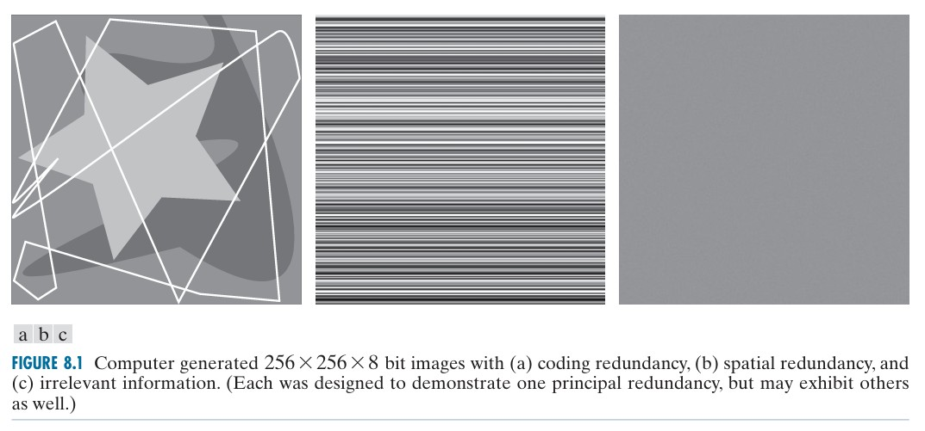

Slide 6
CODING REDUNDANCY
Assume that a discrete random variable r_{k} in the interval [0, L-1] resent the intensities of an M×N image, and that each r_{k} occurs with probability 𝑝_{𝑟}(𝑟_{𝑘}),
As normalized histogram we can write, 𝑝 𝑟 = ^{𝑛𝑘} , k= 0,1,2,3,……..,L-1.
𝑟 𝑘
𝑀𝑁
where L is the number of intensity values, and n_{k} is the number of times that the kth intensity appears in the image. If the number of bits used to represent each value of r_{k} is l(r_{k}), then the average number of bits required to represent each pixel is
𝐿−1
𝐿_{𝑎𝑣𝑔} = ෍ 𝑙 𝑟_{𝑘} 𝑝_{𝑟} 𝑟_{𝑘}
𝑘=0
𝑙 𝑟_{𝑘} can be variable or fixed.

Slide 7
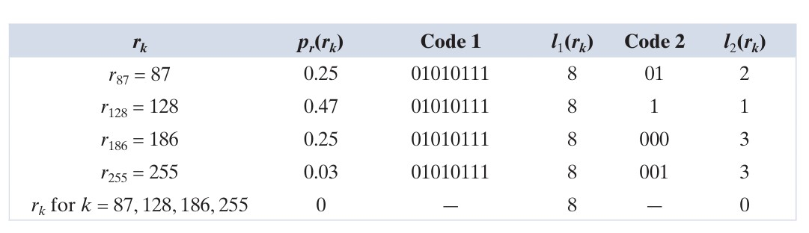
CODING REDUNDANCY--- EXAMPLE
For Code 1, L_{avg} = 8 bits,
For Code 2, L_{avg} = 2(0.25)+1(0.47)+3(0.25)+3(0.03)= 1.81 bits
𝐶 =
𝑅 = 1 − = 1 −
=
1
256×256×8
8
= 4.42; Size of total image = 𝑀𝑁𝐿
256×256×1.81
1.81
𝑎𝑣𝑔
1
= 0.774; 77.4% of the data in the original 8-bit 2-D intensity
𝐶 4.42
array is redundant

Slide 8

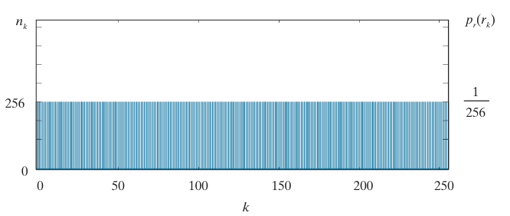
SPATIAL AND TEMPORAL REDUNDANCY
Image Histogram
All 256 intensities are equally probable. As Fig. shows, the histogram of the image is uniform.
Because the intensity of each line was selected randomly, its pixels are independent of one another in the vertical direction.
Because the pixels along each line are identical, they are maximally correlated (completely dependent on
one another) in the horizontal direction
Using run-length pairs, where each run-length pair specifies the start of a new intensity and the number of consecutive pixels that have that intensity.
It compressed a 2-D image intensity array by [256×256×8] /[(256+256)×8] or 128:1. Each 256-pixel line of the original representation is replaced by a single 8-bit intensity value and length 256 in the run-length representation.

Slide 9

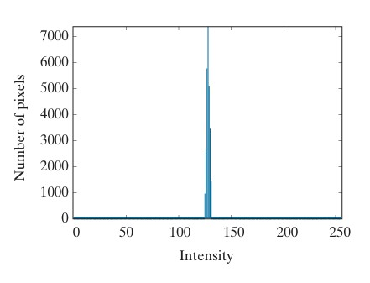
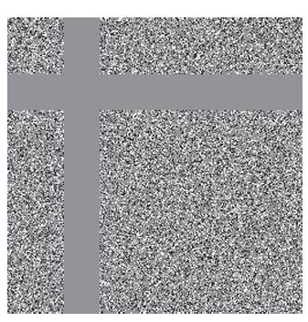
IRRELEVANT INFORMATION
it appears to be a homogeneous field of gray, can be represented by its average intensity alone—a single 8-bit value.
a histogram equalized version of the image makes the intensity changes visible and reveals two previously undetected regions of constant intensity—one oriented vertically, and the other horizontally.
If the image represented by its average value alone, this “invisible” structure (i.e., the constant intensity regions) and the random intensity variations surrounding them (real information) is lost. Whether or not this information should be preserved is application dependent.

Slide 10

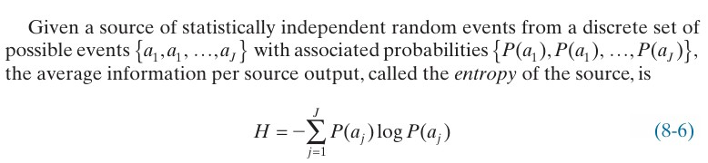
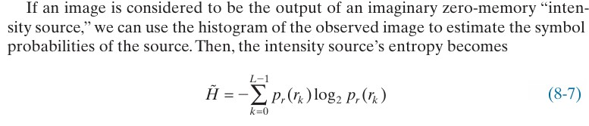
MEASURING IMAGE INFORMATION
In accordance with this supposition, a random event E with probability P(E) is said to contain

Slide 11
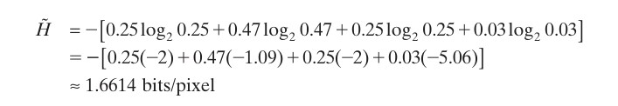
EXAMPLE
From the previous example

Slide 12
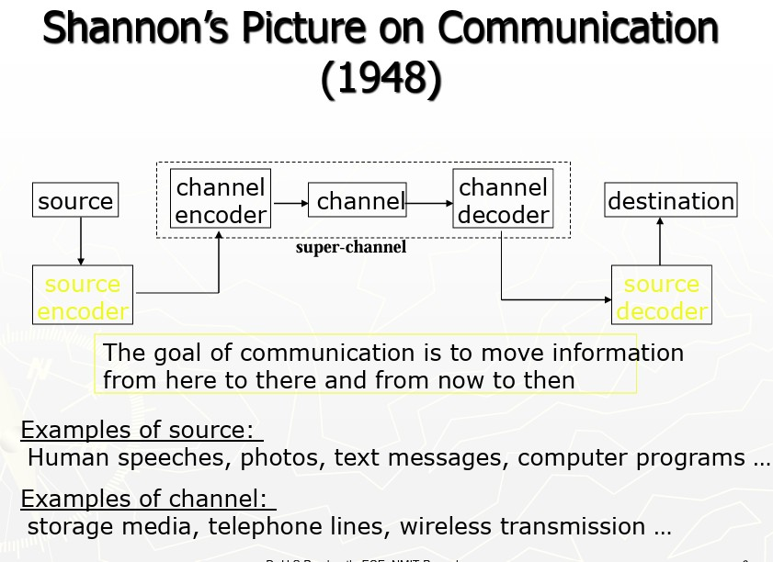

Slide 13
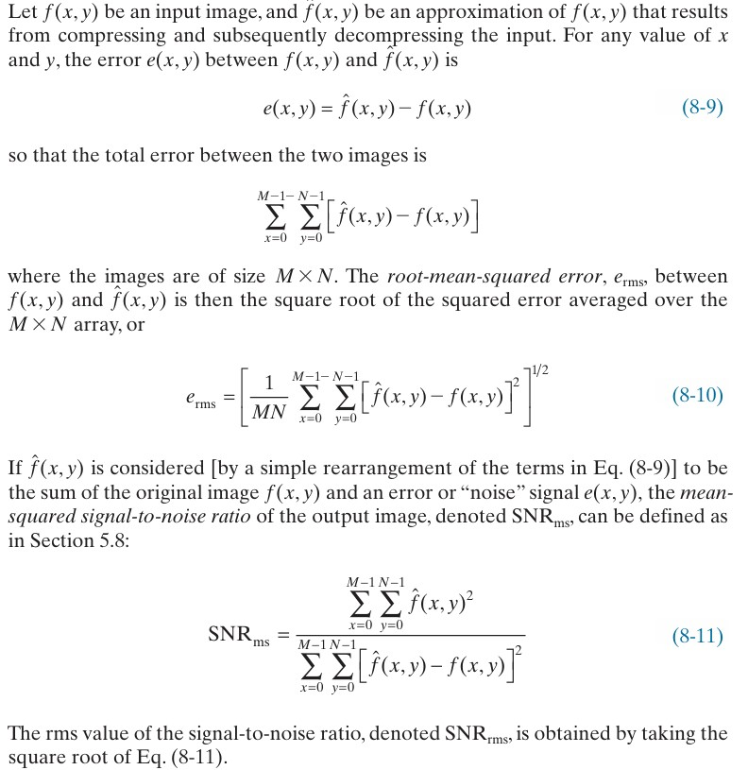
FIDELITY CRITERIA
Compression can loss information.
Two types of criteria can be used for such an assessment: (1) objective fidelity criteria, and (2) subjective fidelity criteria.
When information loss can be expressed as a mathematical function of the input and output of a compression process, it is said to be based on an objective fidelity criterion. An example is the root-mean- squared (rms) error between two images.
Subjective is judged by human

Slide 14

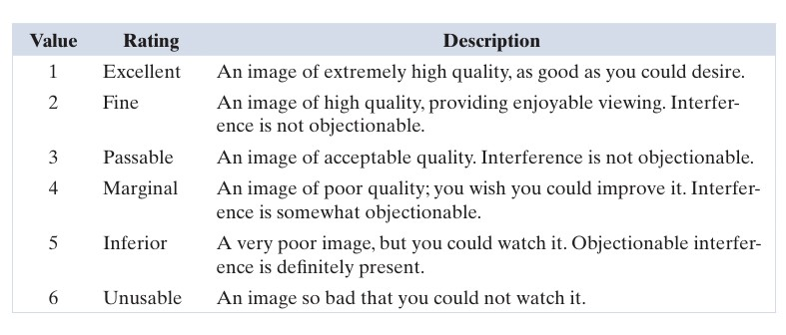
FIDELITY CRITERIA-- EXAMPLE
rms errors are 5.17, 15.67, and 14.17 intensity levels,

Slide 15
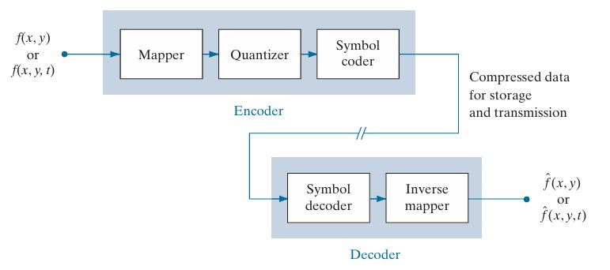
IMAGE COMPRESSION MODEL
an image compression system is composed of two distinct functional components: an encoder and a decoder.
The encoder performs compression, and the decoder performs the complementary operation of decompression. Both operations can be performed in software, as is the case in Web browsers and many commercial image-editing applications, or in a combination of hardware and firm ware, as in commercial DVD players.
A codec is a device or program that is capable of both encoding and decoding

Slide 16
IMAGE COMPRESSION MODEL
A mapper transforms input into a (usually nonvisual) for mat designed to reduce spatial and temporal redundancy. This operation generally is reversible, and may or may not directly reduce the amount of data required to represent the image.
The quantizer in Fig. 8.5 reduces the accuracy of the mapper’s output in accor dance with a pre-established fidelity criterion. The goal is to keep irrelevant information out of the compressed representation. As noted earlier, this operation is irreversible.
In the third and final stage of the encoding process, the symbol coder generates a fixed- length or variable-length code to represent the quantizer output, and maps the output in accordance with the code. This operation is reversible.

Slide 17
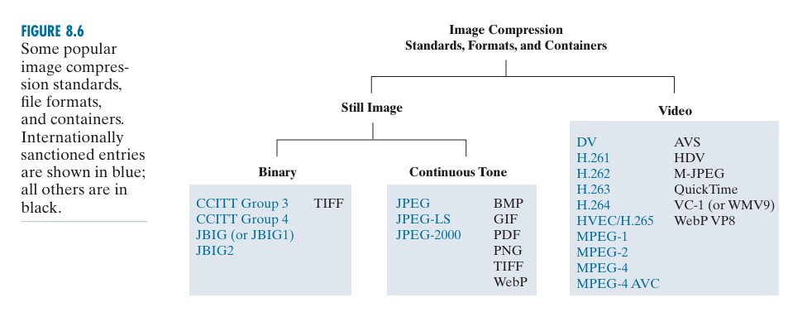
COMPRESSION STANDARD

Slide 18
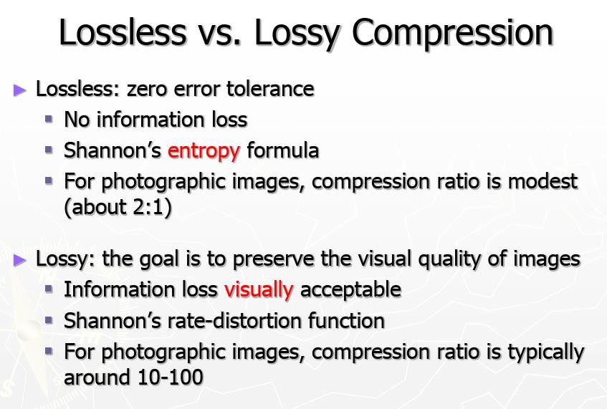

Slide 19
IMAGE WATERMARKING
Images distributed in the internet can be copied repeatedly and without error, putting the rights of their owners at risk.
Even encrypted images becomes unprotected after decryption.
One way to discourage illegal duplication is to insert one or more items of information, collectively called a watermark.
Digital image watermarking is the process of inserting data into an image in
such a way that it can be used to make an assertion about the image.
Watermarking is opposite to compression.

Slide 20
DIFFERENT WAYS OF WATERMARKING
Copyright identification-- Watermarks can provide information that serves as proof of
ownership when the rights of the owner have been infringed.
User identification or fingerprinting -- The identity of legal users can be encoded in watermarks and used to identify sources of illegal copies.
Authenticity determination -- The presence of a watermark can guarantee that an image has not been altered, assuming the watermark is designed to be destroyed by any modification of the image.
Automated monitoring -- Watermarks can be monitored by systems that track when and where images are used (e.g., programs that search the Web for images placed on Web pages). Monitoring is useful for royalty collection and/or the location of illegal users.
Copy protection -- Watermarks can specify rules of image usage and copying (e.g., to DVD players).

Slide 21
TYPES OF WATERMARKING
Visible Watermarks – These watermarks are visible. It is an opaque or semi-transparent sub image or image that is placed on top of another image (i.e., the image being watermarked) so that it is obvious to the viewer. Television networks often place visible watermarks (fashioned after their logos) in the upper or lower right-hand corner of the television screen.
Invisible Watermarks – These watermarks are embedded in the media and use
steganography technique. They are not visible by naked eyes.
Public Watermarks – These can be understood and modified by anyone using certain algorithms. These are not secure.
Fragile Watermarks – These watermarks are destroyed by data manipulation. There must be
a system which can detect all changes in the data if fragile watermarks are to be used.

Slide 22
DIGITAL WATERMARKING PROCESS (LIFE CYCLE) :
The information needs be embedded in the media. The signal which is embedded is the host signal and the information is called digital watermark. The process has 3 main parts:
Embed – In this part, the digital signal is embedded with the digital watermark.
Attack – The moment when the transmitted media is changed, it becomes a threat and is called an attack to the watermarking system.
Protection – The detection of the watermark from the noisy signal which might have altered media (JPEG compression, rotation, cropping, and adding noise) is called Protection.

Slide 23
APPLICATIONS
Watermarks are used in forensics. Tampered evidence is unacceptable in forensics and Watermarked images are acceptable.
This is used by brands. The Digital Watermarking is done so that the authority of the digital media is intact.
Digital Watermarking prevents copying of the data.
Video editing software use watermarks so that people buy the full version of it.
It is used in video authentication. News channels often show videos of other agencies which are watermarked. It is also used for ID card security.
It is used for content management in social media.

Slide 24
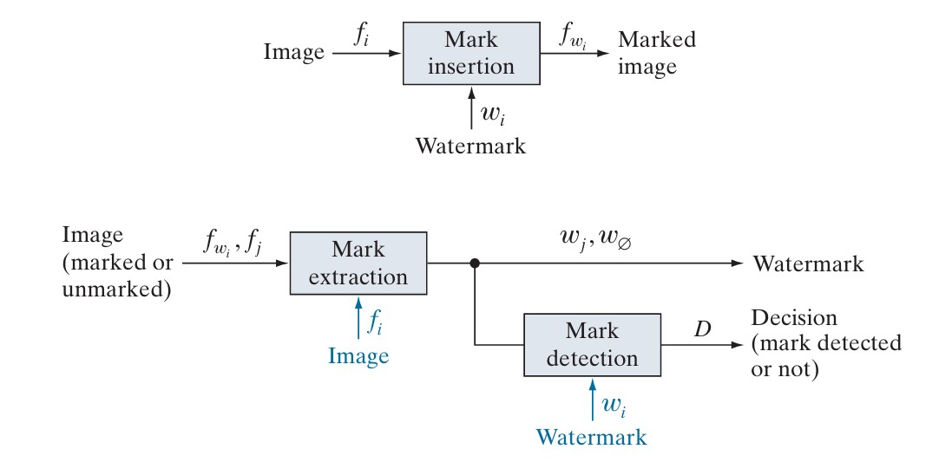
WATERMARKING SYSTEM

